Slide 1
Customer Segmentation – For Marketing Strategy Clustering Project
Train Dataset
31647 instances and 18 features with 10 features of object datatype, 3 features of integer and 5 features of float datatype.
No duplicate rows
1 unique column – ID
Missing Values – yes
Test Dataset
13564 rows, 17 columns with 10 object datatype features, 2 integer datatype features and 5 features of float datatype.
No duplicate rows
1 unique column – ID
Missing Values – yes

Slide 2
Statistical Summary of Train Dataset ( similar for Test Dataset as well ):
Customer Age ranges from 18 to 97
Balances from -8020 to 102128
Day of the month from 1st to 31st of the month
Last contact duration 0 secs to 4900 secs ie.1.36 hours
Number of contacts in campaign ranging from 1 contact to 63 contacts made during the campaign
Days since previous campaign contact ranging from 1 day to 871 days since last contact ie.28 months (2.3years).
Number of contacts in previous campaign from 0 to 275 contacts made.
Term Deposit subscribed is 0 and 1. ( 0 for not subscribed and 1 for subscribed)
Numerical Features :
Age of customer.
Balance in the bank account
Day of month the customer was contacted
Duration of last contact in seconds
Number of contacts made during the campaign
Number of days since contacted during previous campaign
Number of contacts made during previous campaign
Term deposit subscribed ( not included in Test Dataset)
Categorical Features:
Type of Job of the customer
Marital status of customer
Education level of customer
Default status of any credit
Any Housing loan taken
Any personal loan taken
Mode of communication
Month in which customer was contacted
Outcome of previous campaign

Slide 3
Exploratory Data Analysis
Categorical Variables Distribution (using piechart)
21.5% of customers have a blue-collar job, 21% are management professionals and 16% are technicians.
60% customers are married, 28% are single and 11% are divorced.
51% customers have had secondary level of education, 29.5% with tertiary level of education
98% customers have not defaulted
55% of customers have housing loan and 84% have not taken personal loan
64.7 % were contacted via cellular mode, 29% unknown
30% of customers were contacted in the month of May and 15% in July and least in December
Only 3.4 % success rate outcome of previous campaign, 11% failed outcomes and 81 % are unknown
Univariant Analysis ( Histogram Plot shows)
Most of the customers are:
in the age group of 30-40
Have balances below 20,000
Were contacted around 20th of the month
Call duration less than 1000 secs
Some were contacted upto 10 times
Around 200 days ie. 7 months since previous campaign contact
Number of contacts in previous campaign is less than 50
Majority have not subscribed to term deposits
Bivariant Analysis ( using countplot shows)
Age ranging from 30-50 have subscribed to term deposits
Those contacted between 7th and 22nd of month subscribed to term deposits
More contact duration have subscribed to term deposits
More days since previous campaign contact had lesser subscription
Countplot of categorical features vs term deposit subscribed show:
Customers who opted more term deposits were management professionals, were married, hold secondary education level, no default, those who didn’t have housing loan and personal loan.
Customers who were contacted via cellular communication, contacted in the month of May and unknown outcome of previous campaign.

Slide 4
Data Transformation
Skewness Value | Before Imputation | After IQR method | Yeo Johnson Transformer
Customer Age | 0.6619 | 0.5530 | 0.0033
Balance | 8.5051 | 1.0913 | 1.0673
Day of month | 0.0919 | 0.0919 | -0.158
Last contact duration | 3.1658 | 1.0193 | 0.0772
Number of contacts in campaign | 5.0001 | 1.1003 | 0.2322
Days since previous campaign contact | 0.6494 | Column dropped due to high missing values | Column dropped
Number of contacts in previous campaign | 45.833 | 0 | 1.6363
Term deposit subscribed | 2.538 | Did not treat for outliers since it is target variable | Not transformed
Correlation :
Fairly low correlation among the features. Positive correlation is among the following:
Customer Age and Balance
Day of month and number of contacts in campaign
Last contact duration and term deposit subscribed shows a correlation coefficient of 0.42

Slide 5
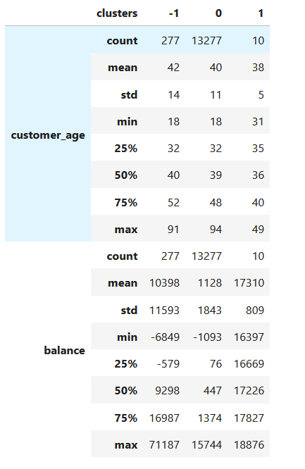

Results from Test Dataset
Clustering
Cluster 0 : represents those who are not likely to subscribe to Term Deposits
Cluster 1 : represents those who are more likely to subscribe to Term Deposits
Cluster -1 : represents the outliers
Those who are likely to subscribe to Term deposits:
Maintain higher balances above 15k
Age between 35-40
Contacted mid of the month
Contact duration lasted more than 250 sec
Contacted more than 3.5 times in the current campaign
Majority are married
Those who had secondary and tertiary level of education
Holding management and blue collar jobs
Having no default in loan
Who opted for housing loan and not personal loan
Contacted in the months of Nov, June, May
Contacted via cellular communication

Slide 6
Marketing Strategy
Key to a successful marketing campaign is to maintain a regular connect with the customer.
For that as the data suggests : maintain regular contact with those clients who maintain higher balances.
Approach the blue collar and management professionals who are well educated with secondary or tertiary degrees and who have higher balances. Although their risk appetite is high, for liquidity we can suggest them to invest in Term deposits as well.
Those who have less debt, have more disposable income and hence approach those whose liability towards home loan and personal loan is less.
Bank should provide attractive interest rates in order to attract the senior citizens. Retirement corpus for these clients will be on the higher side and they tend to invest in Term deposits and hence attractive interest rate will draw them in.
Contact around the 2nd week of the month and not wait till the month end when customers tend to pay any outstanding bills.
Approach customers in May, June and November as well, May and June being the mid year and November is before the winter holiday expenses.
Married folks are most likely earning double income (couple) and hence for liquidity and to inculcate savings Term Deposits are a good investment option.

Slide 7
Marketing Strategy: Target
Customers having Higher Balances
Contact during May, June, November
Attractive Interest Rates
No debt / default
Married
Retired
Blue Collar jobs and Management
Professionals
KEY:
Maintain Regular Contact

